Slide 1

One year.
One perspective.
One planet.
An asset owner's lens on the year
Faith Ward | Faith in RI | Global Asset Owner Forum, PRI | October 2026
Notes:
Good morning. When this Forum last met, in November 2025, all eyes were on Belém. I want to use the next eight minutes to look back at the year since then through an asset owner's lens, one month at a time.
[Image: click the icon in the lens to add NASA's Blue Marble (public domain); it crops to the circle.]

Slide 2






















The year at a glance
M | T | W | T | F | S | S
 |  |  | 1 | 2 | 3 | 4
5 | 6 | 7 | 8 | 9 | 10 | 11
12 | 13 | 14 | 15 | 16 | 17 | 18
19 | 20 | 21 | 22 | 23 | 24 | 25
26 | 27 | 28 | 29 | 30 | 31
NOV 2025
DEC 2025
JAN 2026
FEB 2026
MAR 2026
APR 2026
COP30; Tehran water
Asia floods; EU Omnibus
Nature security
UK SRS; Iran war
Hormuz; private credit
Food shock
MAY 2026
JUN 2026
JUL 2026
AUG 2026
SEP 2026
OCT 2026
Bond yields; FSB
SpaceX; AI; SEC
Fire and drought
Nepal glacier; heat
Gilts; boundaries; SEC
Super El Niño
Notes:
One year, two dozen headlines. None will be new to you. What I would ask you to notice is how they connect, and how quickly one shock has landed on the next. Each is a conversation starter for today.

Slide 3
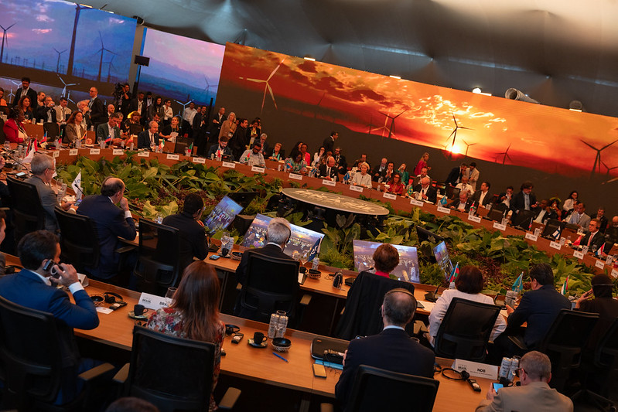
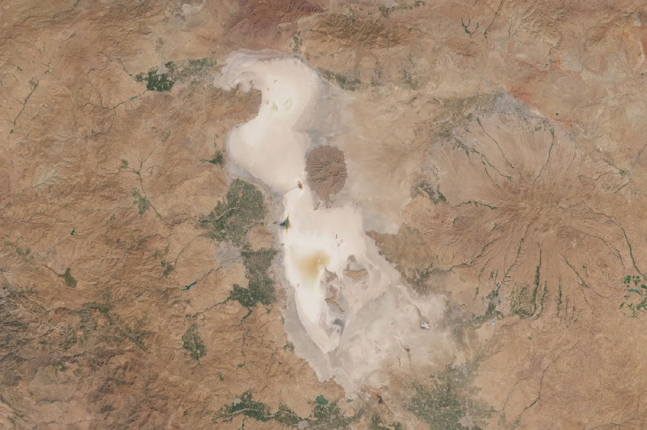


November 2025
M | T | W | T | F | S | S
 |  |  |  |  | 1 | 2
3 | 4 | 5 | 6 | 7 | 8 | 9
10 | 11 | 12 | 13 | 14 | 15 | 16
17 | 18 | 19 | 20 | 21 | 22 | 23
24 | 25 | 26 | 27 | 28 | 29 | 30
COP30 ends without a fossil-fuel roadmap
Tehran warned it may have to evacuate as water runs out
Sources: The Namibian; Khaleej Times; UNFCCC; Copernicus Sentinel data 2025.
Notes:
November. COP30 closed without a roadmap away from fossil fuels. In the same month, Iran's president warned that Tehran might have to be evacuated if the rains failed. Policy ambition stalled just as physical limits began to bite.

Slide 4
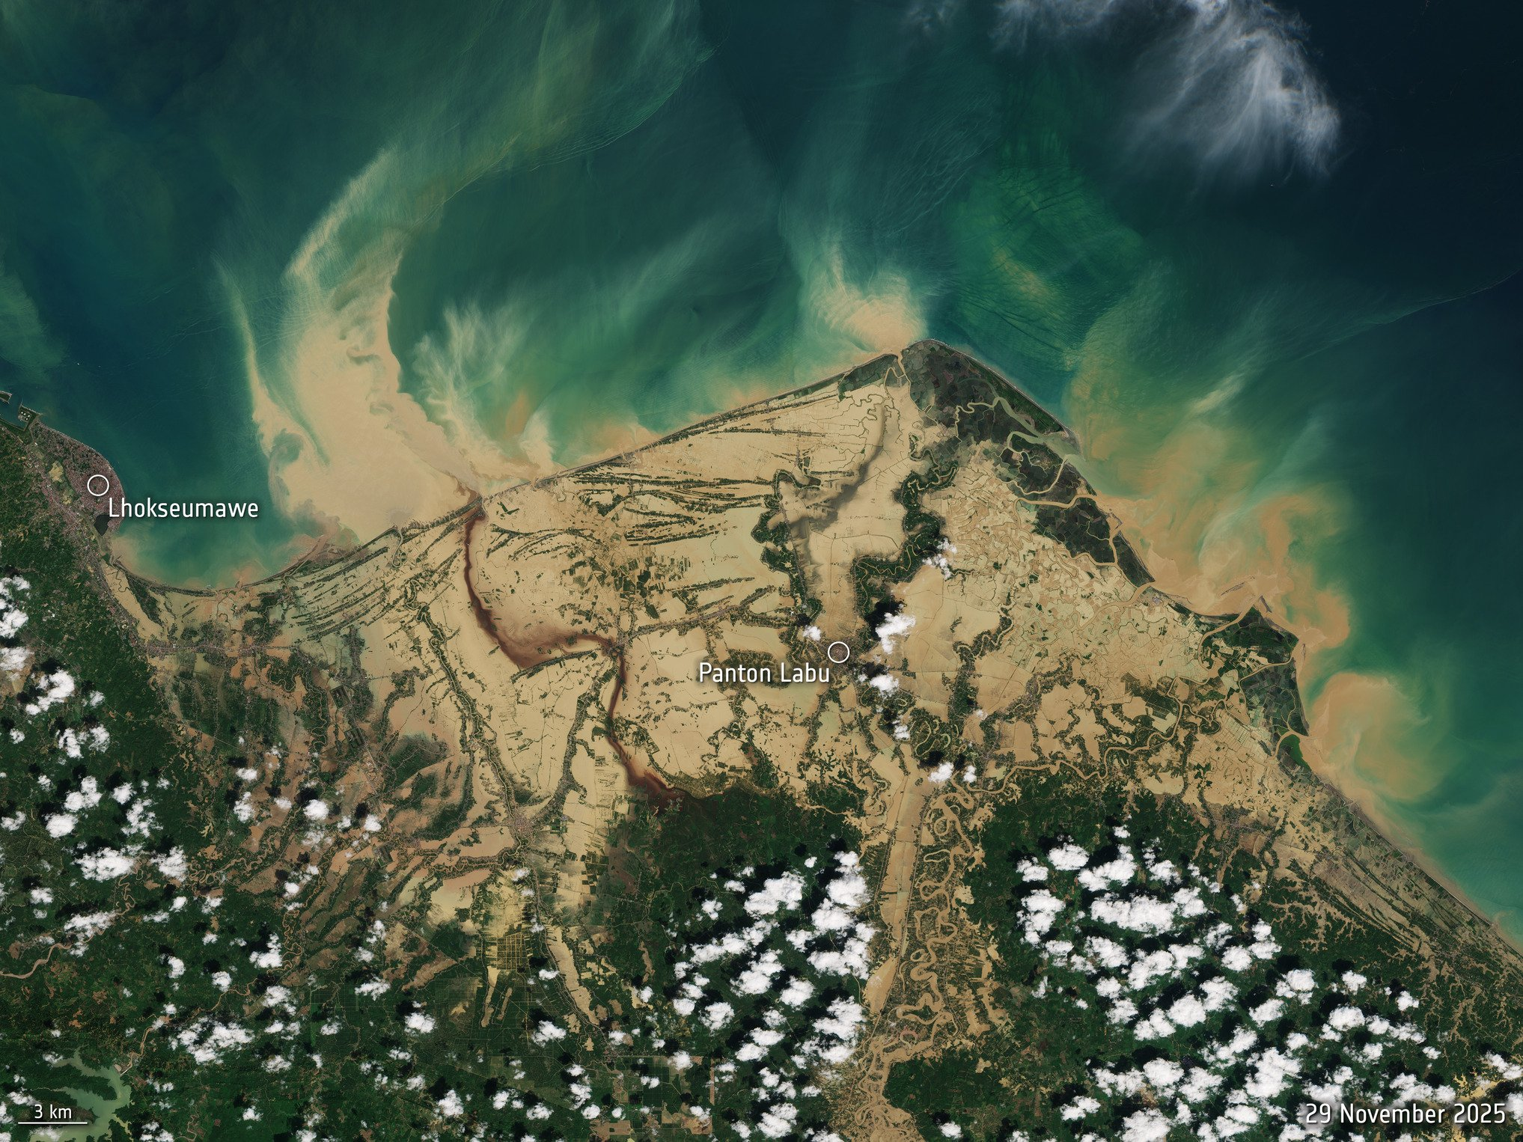
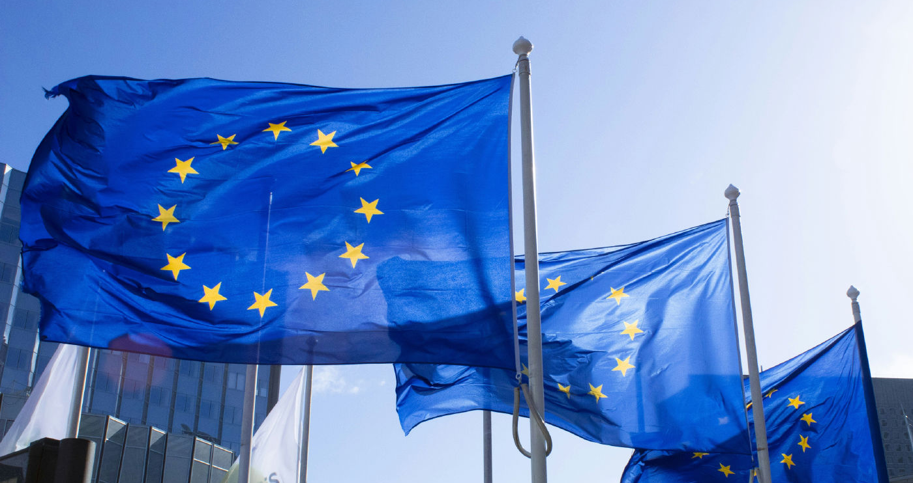


December 2025
M | T | W | T | F | S | S
1 | 2 | 3 | 4 | 5 | 6 | 7
8 | 9 | 10 | 11 | 12 | 13 | 14
15 | 16 | 17 | 18 | 19 | 20 | 21
22 | 23 | 24 | 25 | 26 | 27 | 28
29 | 30 | 31
Cyclones and floods kill 1,750+ in Sumatra and Sri Lanka
EU Omnibus cuts CSRD and CSDDD scope
Sources: Katadata (Indonesia); Ada Derana (Sri Lanka); De Brauw; ESA; photo: alexandrelallemand.com
Notes:
December. Cyclones and floods killed more than 1,750 people in Sumatra and Sri Lanka alone. In Brussels, the EU agreed its Omnibus package, narrowing who must report under the CSRD and dropping the duty to adopt a climate transition plan. Losses mounted just as the information investors rely on was cut back.

Slide 5
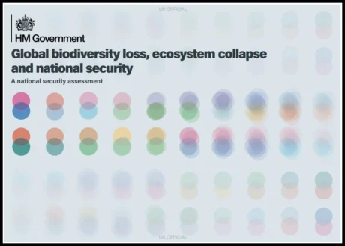

January 2026
M | T | W | T | F | S | S
 |  |  | 1 | 2 | 3 | 4
5 | 6 | 7 | 8 | 9 | 10 | 11
12 | 13 | 14 | 15 | 16 | 17 | 18
19 | 20 | 21 | 22 | 23 | 24 | 25
26 | 27 | 28 | 29 | 30 | 31
UK names ecosystem collapse a national security risk
Sources: GOV.UK (Defra), 20 January 2026
Notes:
January. The UK government published an assessment naming global biodiversity loss and ecosystem collapse as a national security risk, with consequences for food, water, health and supply chains. Nature moved from the environment brief to the security brief.

Slide 6
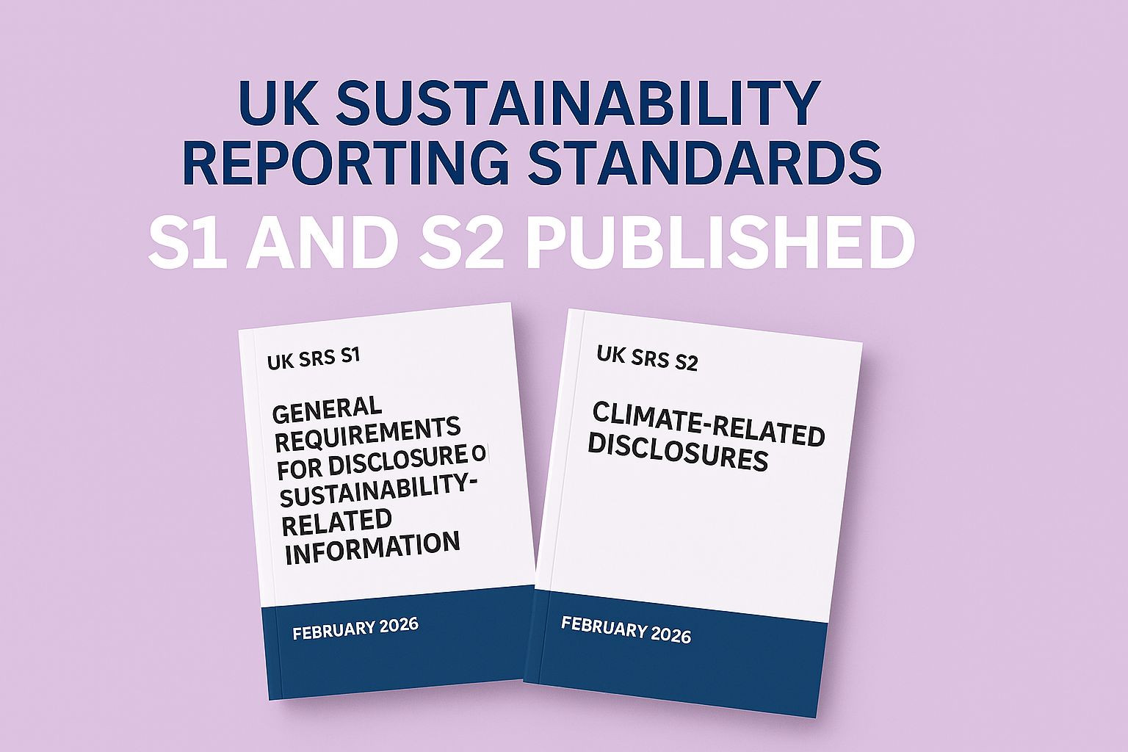
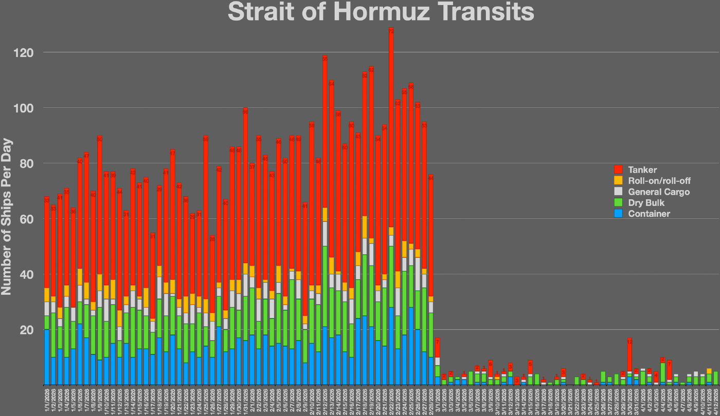


February 2026
M | T | W | T | F | S | S
 |  |  |  |  |  | 1
2 | 3 | 4 | 5 | 6 | 7 | 8
9 | 10 | 11 | 12 | 13 | 14 | 15
16 | 17 | 18 | 19 | 20 | 21 | 22
23 | 24 | 25 | 26 | 27 | 28
UK sustainability reporting standards published
US-Israeli strikes on Iran, 28 February
Sources: Grant Thornton (LinkedIn); Wikideas1 (Wikimedia Commons)
Notes:
February. The UK published its sustainability reporting standards, for voluntary use. Then, on the 28th, US and Israeli strikes on Iran began a war we are still living with. Geopolitical risk stopped being a tail scenario.

Slide 7
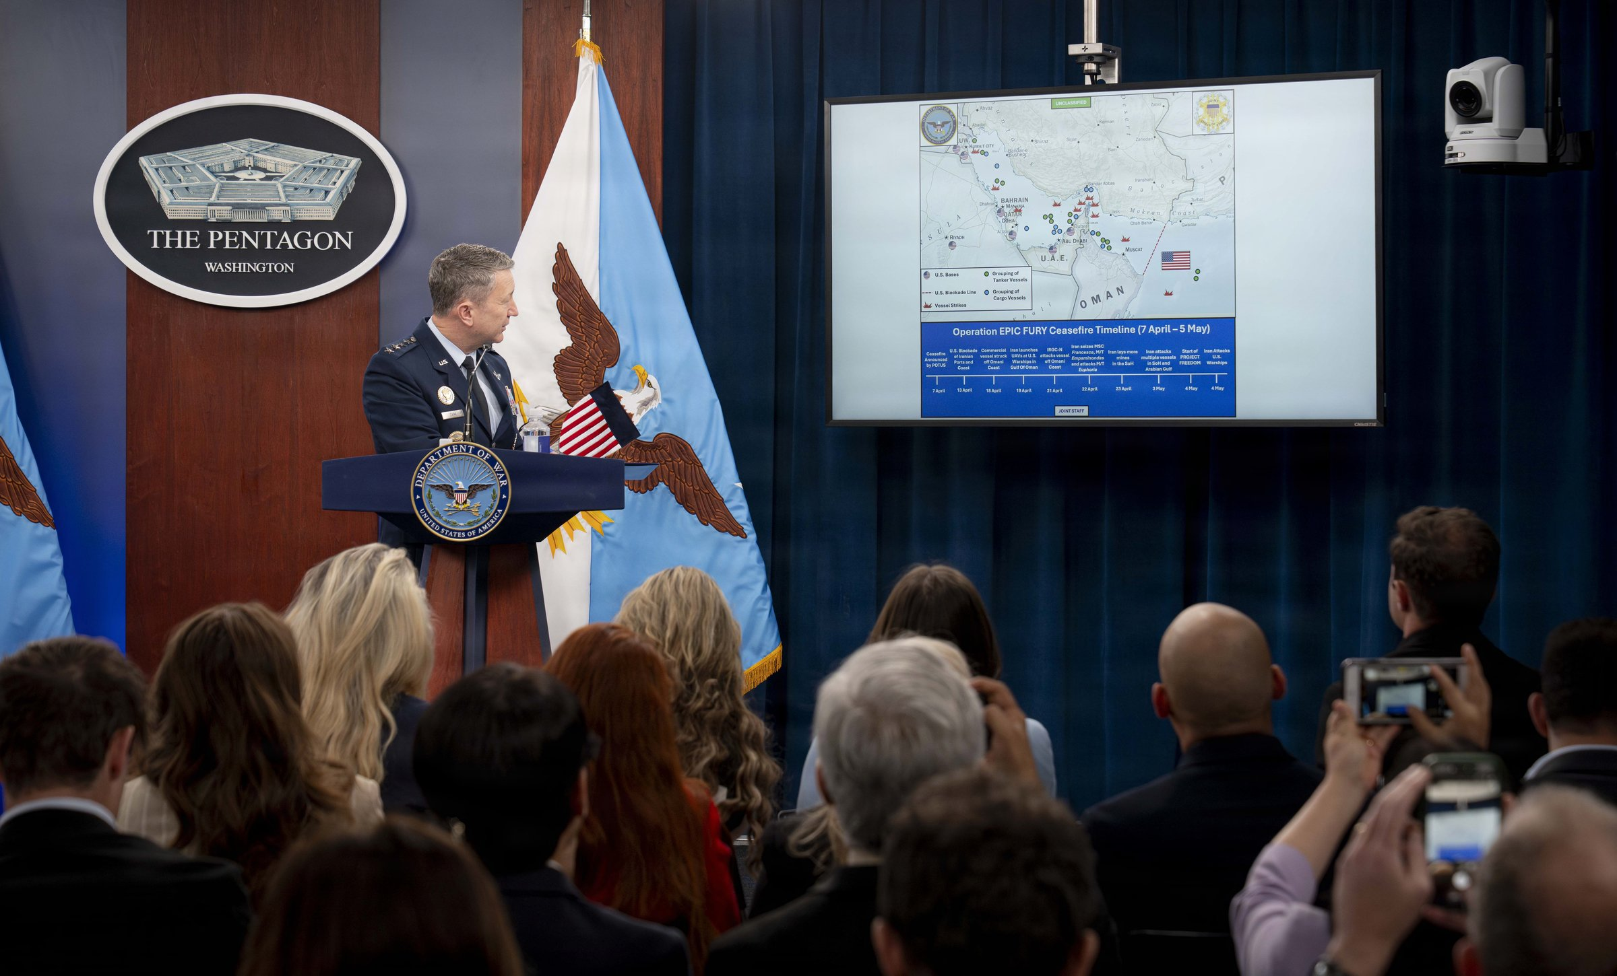
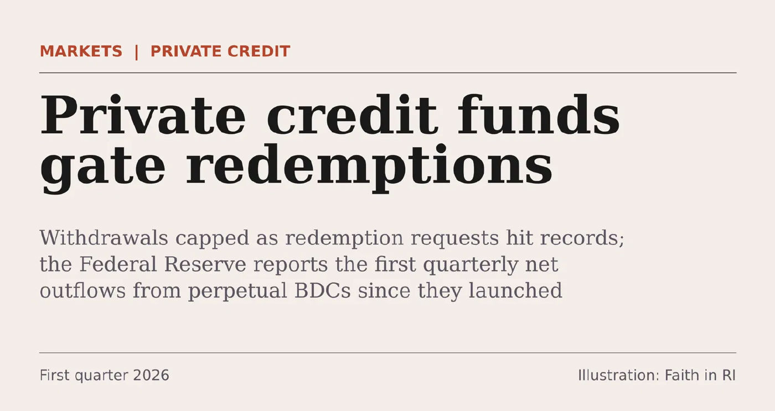


March 2026
M | T | W | T | F | S | S
 |  |  |  |  |  | 1
2 | 3 | 4 | 5 | 6 | 7 | 8
9 | 10 | 11 | 12 | 13 | 14 | 15
16 | 17 | 18 | 19 | 20 | 21 | 22
23 | 24 | 25 | 26 | 27 | 28 | 29
30 | 31
Strait of Hormuz closes; Brent passes $100
Private credit funds gate redemptions
Sources: US Department of Defense (photo ID 260505-D-LS763-1005); Fitch Ratings; Federal Reserve. Illustration: Faith in RI
Notes:
March. The Strait of Hormuz, which carries around a fifth of the world's oil and LNG, was effectively closed, and Brent passed 100 dollars. In private markets, some of the largest private credit funds limited withdrawals. An energy shock and a liquidity test arrived in the same quarter.

Slide 8
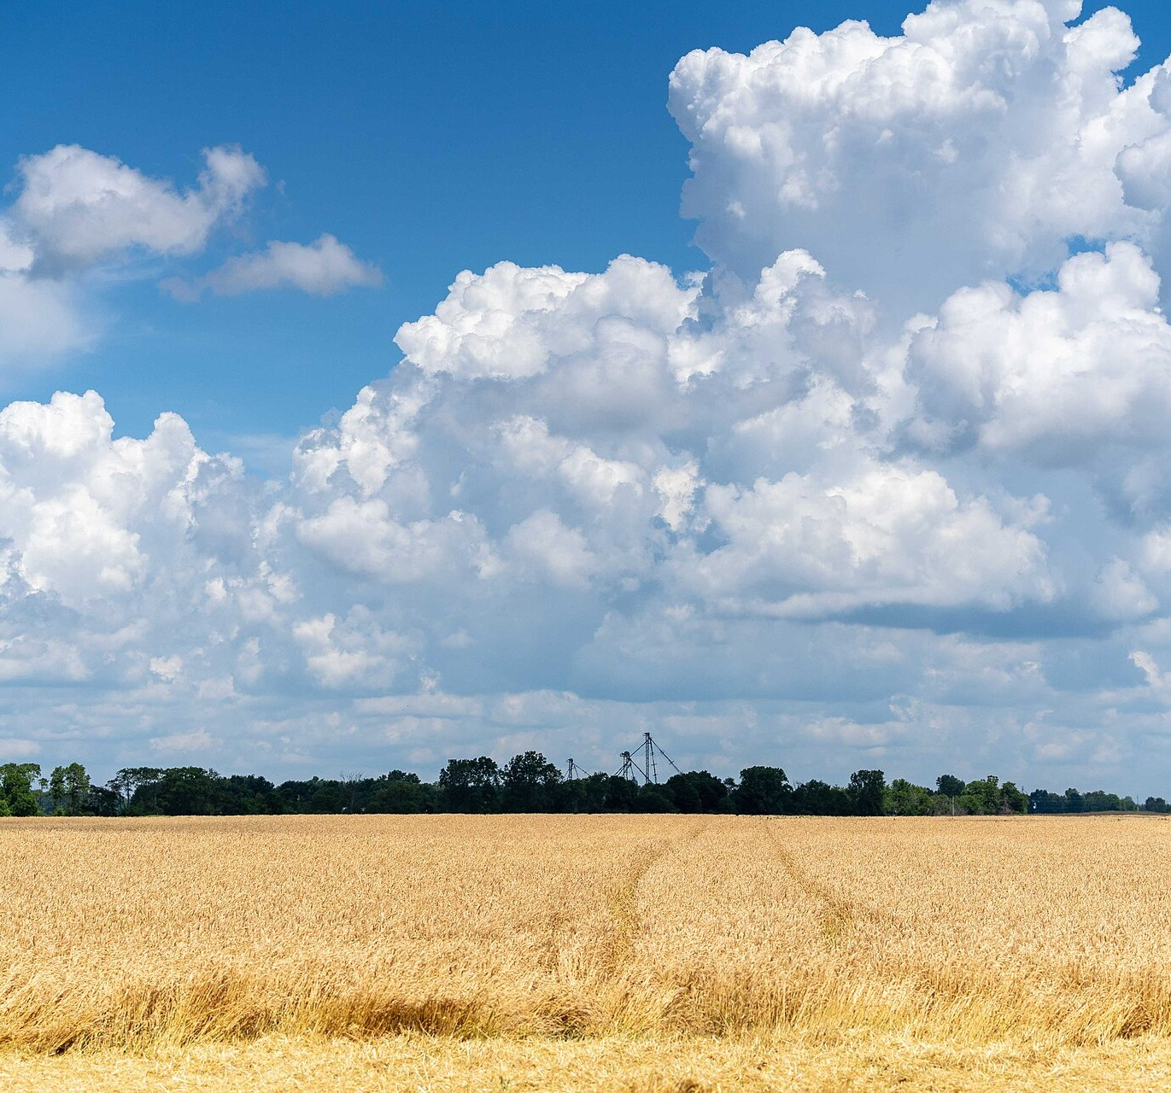
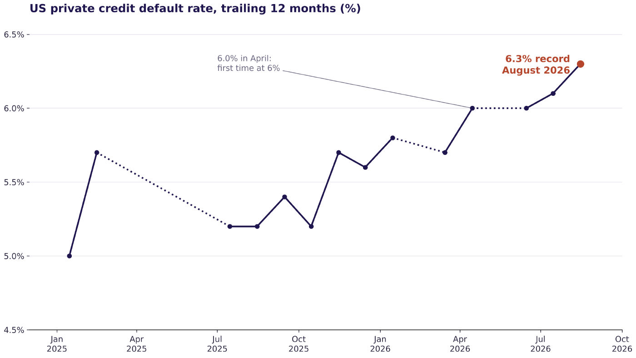


April 2026
M | T | W | T | F | S | S
 |  | 1 | 2 | 3 | 4 | 5
6 | 7 | 8 | 9 | 10 | 11 | 12
13 | 14 | 15 | 16 | 17 | 18 | 19
20 | 21 | 22 | 23 | 24 | 25 | 26
27 | 28 | 29 | 30
FAO warns of a
food 'catastrophe'
US private credit defaults reach 6%
Sources: Al Jazeera (FAO); Fitch Ratings monthly releases, as reported. Chart: Faith in RI (axis does not start at zero). Photo: USDA NRCS (public domain)
Notes:
April. The FAO warned of a global food catastrophe if the disruption persisted: nearly half of the world's traded urea leaves the Gulf through Hormuz. Fitch's US private credit default rate reached six per cent. War became a food price shock, felt first by the poorest importing countries.

Slide 9
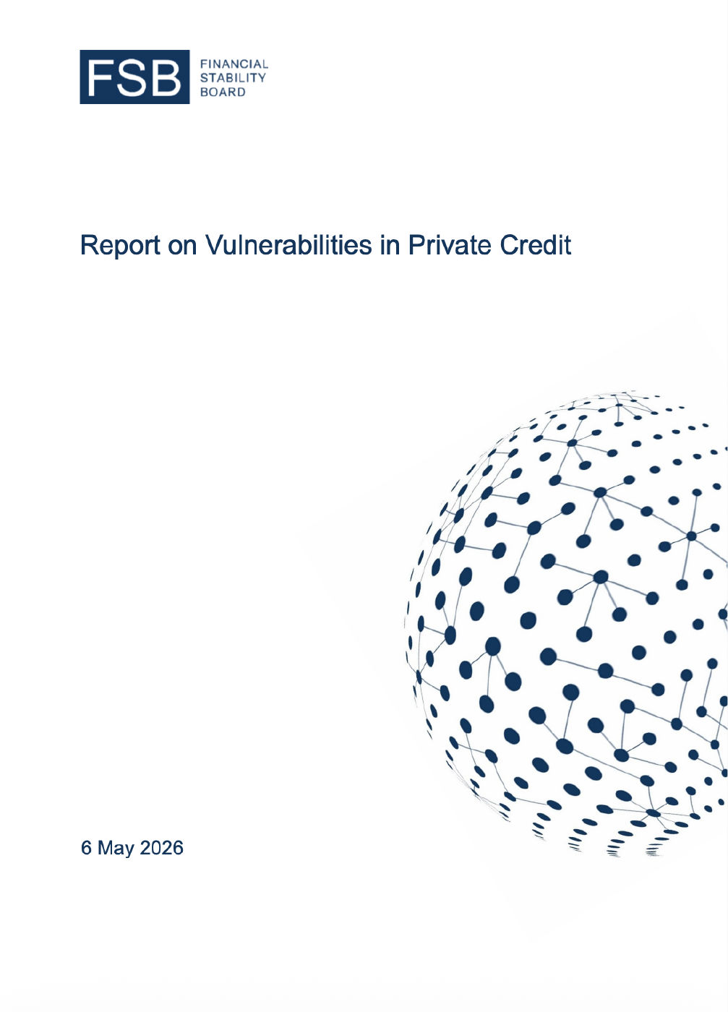
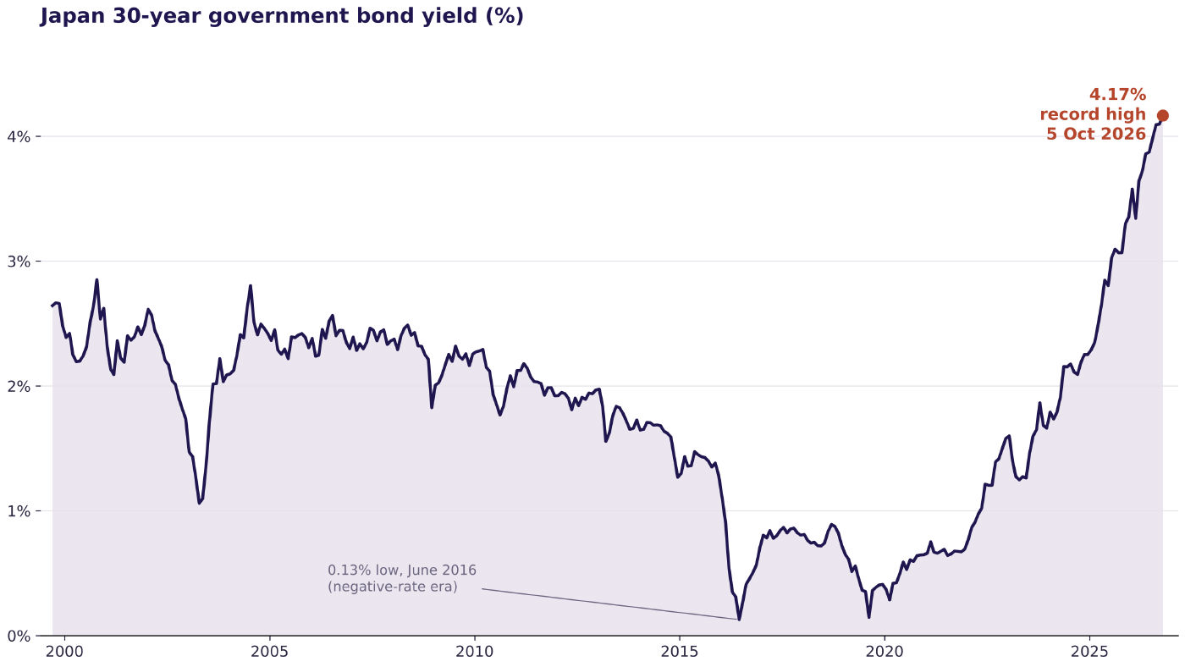


May 2026
M | T | W | T | F | S | S
 |  |  |  | 1 | 2 | 3
4 | 5 | 6 | 7 | 8 | 9 | 10
11 | 12 | 13 | 14 | 15 | 16 | 17
18 | 19 | 20 | 21 | 22 | 23 | 24
25 | 26 | 27 | 28 | 29 | 30 | 31
Japan's 30-year bond yield sets a record
FSB warns on private credit
Sources: Ministry of Finance Japan, JGB interest rates (month-end, September 1999 to 5 October 2026). Chart: Faith in RI; Financial Stability Board
Notes:
May. Japan's 30-year bond yield set a record, and the Financial Stability Board issued a formal warning on private credit. The era of cheap long-term money is over, and the system's buffers are thinner.

Slide 10
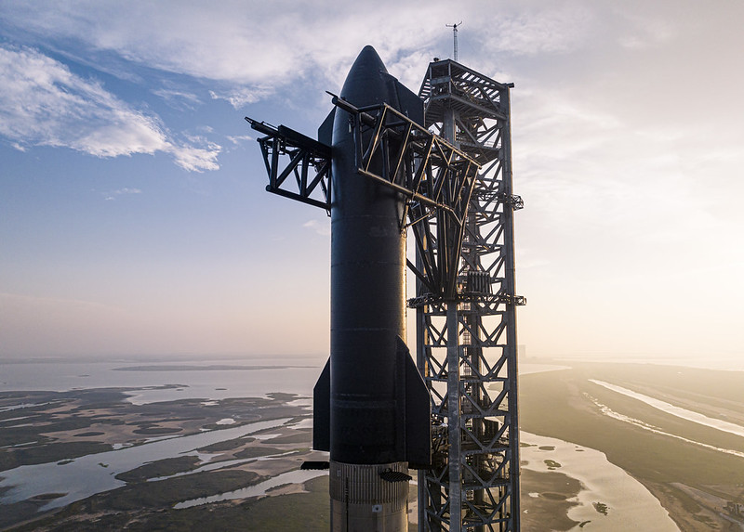





June 2026
M | T | W | T | F | S | S
1 | 2 | 3 | 4 | 5 | 6 | 7
8 | 9 | 10 | 11 | 12 | 13 | 14
15 | 16 | 17 | 18 | 19 | 20 | 21
22 | 23 | 24 | 25 | 26 | 27 | 28
29 | 30
SpaceX: largest IPO ever, Musk keeps 82% of votes
AI stocks sell off
SEC moves to scrap its climate disclosure rule
Sources: AFP via Chronicle.lu; Jang; Creditflux; Cooley. Photo: Chenyu Guan (CC BY-NC 2.0)
Notes:
June. SpaceX listed in the largest IPO in history, at a valuation of about 1.77 trillion dollars, with Elon Musk keeping around 82 per cent of the votes. AI stocks sold off sharply. And the SEC proposed rescinding its climate disclosure rule. Investors are gaining exposure while losing both voice and data.

Slide 11
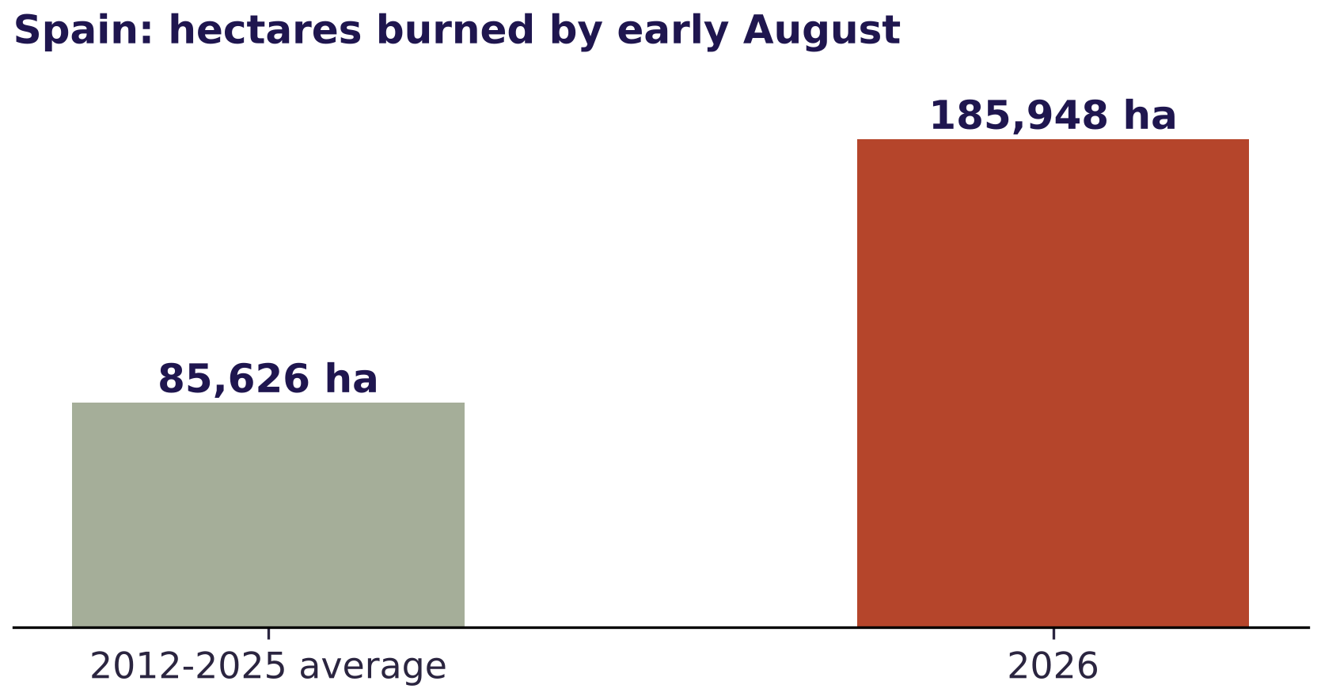
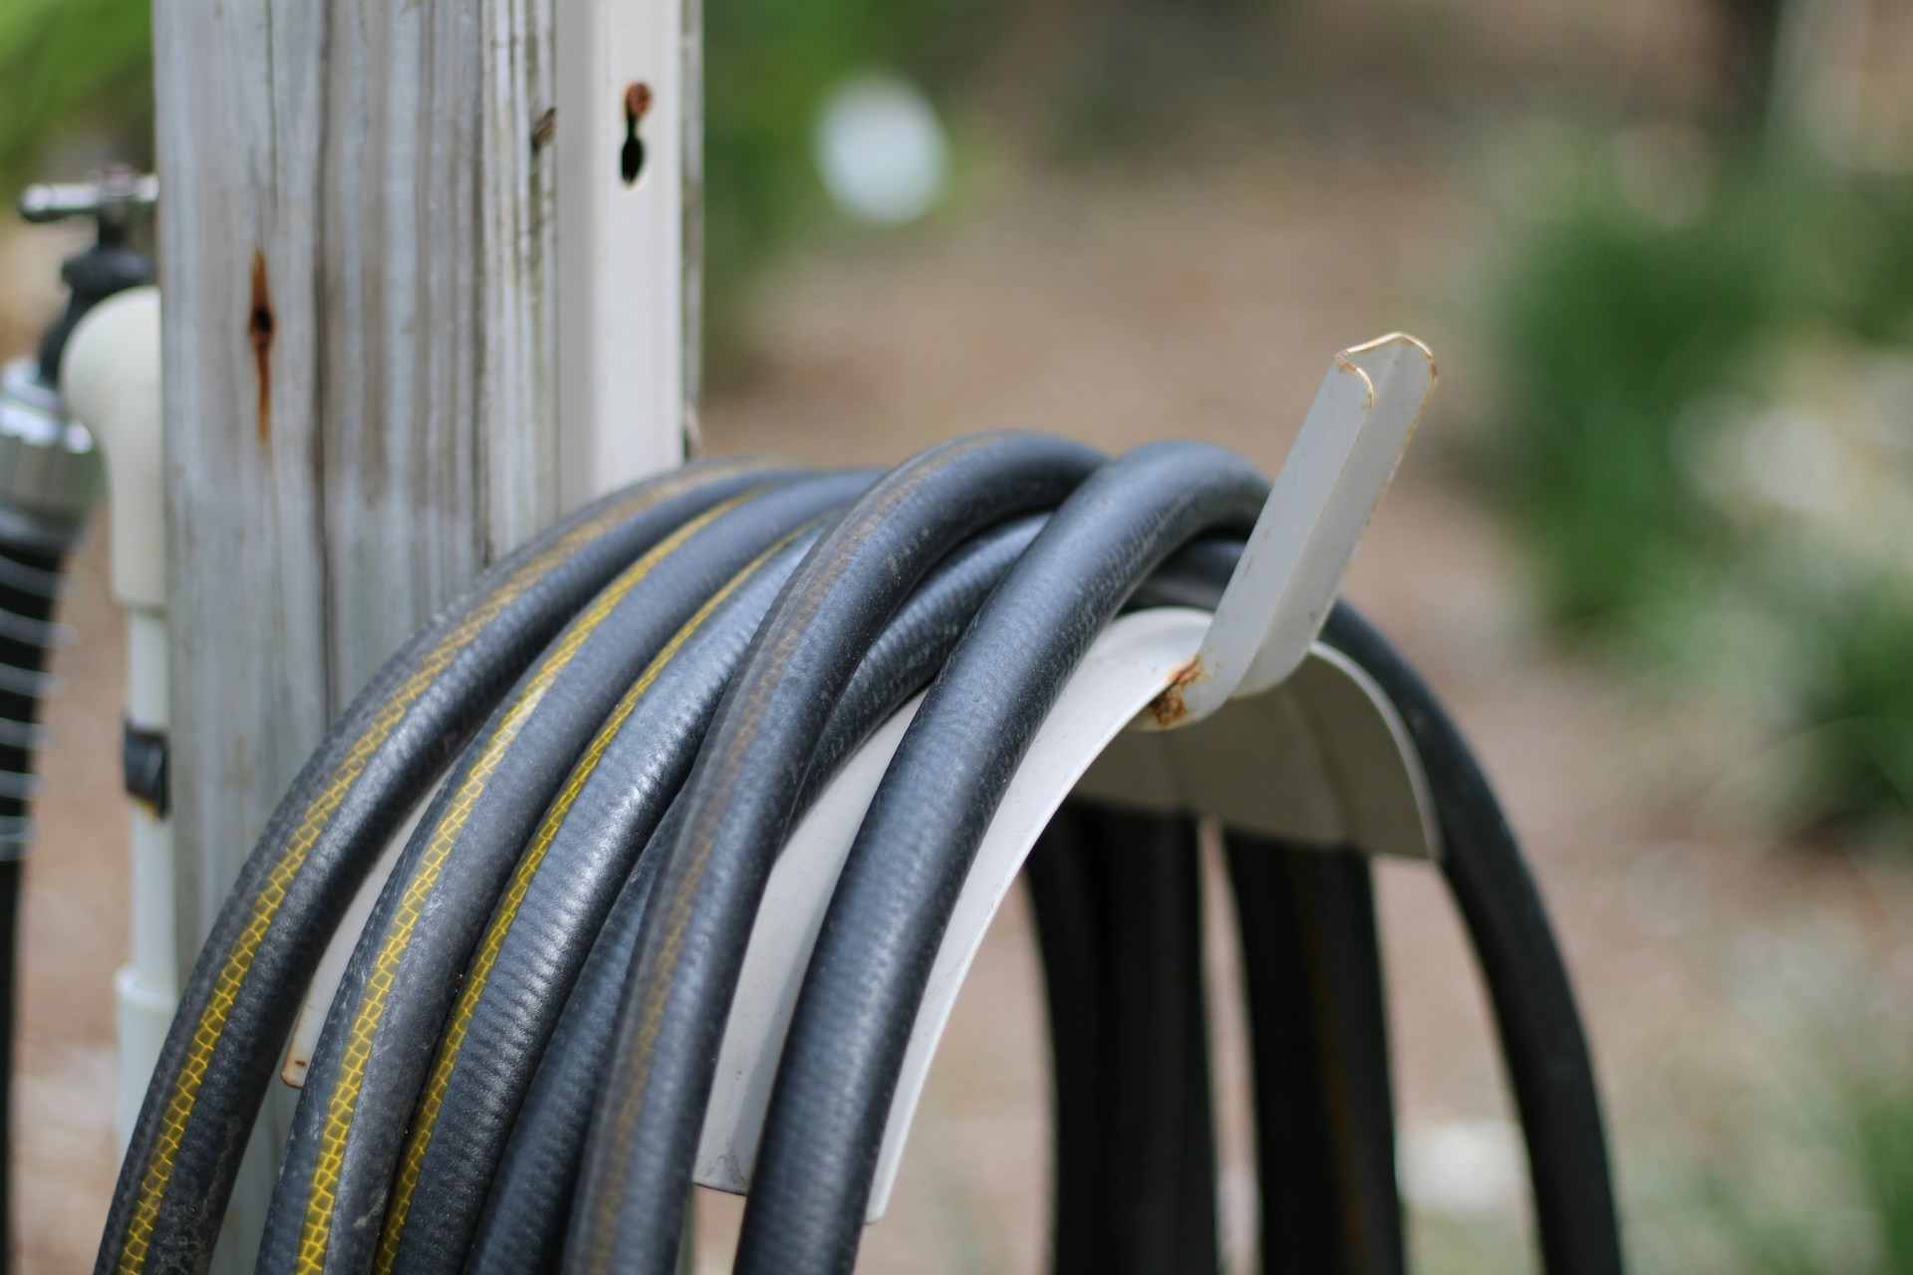


July 2026
M | T | W | T | F | S | S
 |  | 1 | 2 | 3 | 4 | 5
6 | 7 | 8 | 9 | 10 | 11 | 12
13 | 14 | 15 | 16 | 17 | 18 | 19
20 | 21 | 22 | 23 | 24 | 25 | 26
27 | 28 | 29 | 30 | 31
France and Spain break fire records
UK heat and drought: hosepipe bans for millions
Sources: Euronews / EFFIS; Met Office via PA. Chart: Faith in RI using EFFIS data via Euronews. Photo: K Adams on Unsplash
Notes:
July. Wildfires tore through south-west France and central Spain. France burned well beyond its previous record, and more than 320,000 people were evacuated across the two countries. In the UK, heat and drought brought hosepipe bans to millions. Physical risk is now a home-market risk.

Slide 12
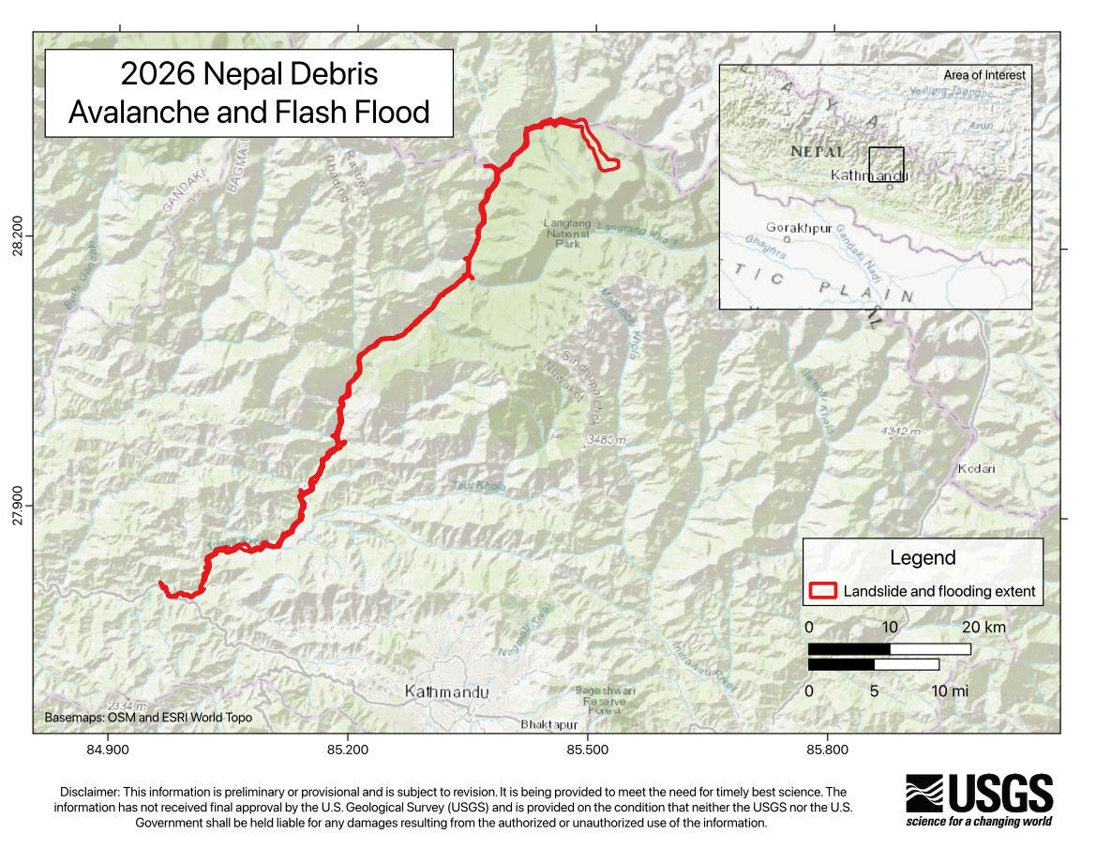
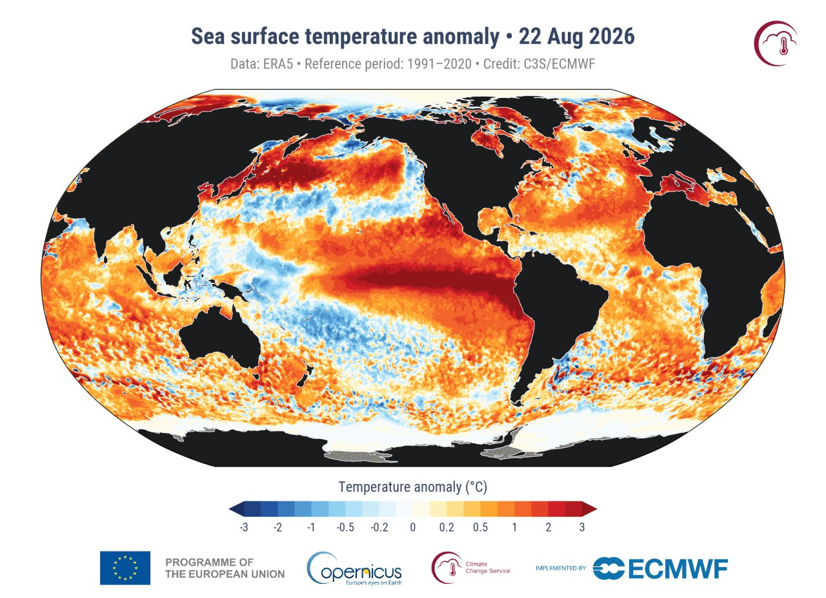


August 2026
M | T | W | T | F | S | S
 |  |  |  |  | 1 | 2
3 | 4 | 5 | 6 | 7 | 8 | 9
10 | 11 | 12 | 13 | 14 | 15 | 16
17 | 18 | 19 | 20 | 21 | 22 | 23
24 | 25 | 26 | 27 | 28 | 29 | 30
31
Glacier collapse in Nepal: ~669 dead, ~2,426 missing
Hottest August on record
Sources: Himal Press (Nepal Police, NDRRMA); WMO; US Geological Survey; Copernicus Climate Change Service
Notes:
August. On the 26th, a glacier and the rock beneath it collapsed on Langtang Lirung, on the Nepal-Tibet border, destroying the main trade crossing with China. Nepal's authorities reported 669 dead and more than 2,400 missing, many of them working on hydropower projects. The world also recorded its hottest August. The cryosphere is now an infrastructure, energy and trade risk.

Slide 13
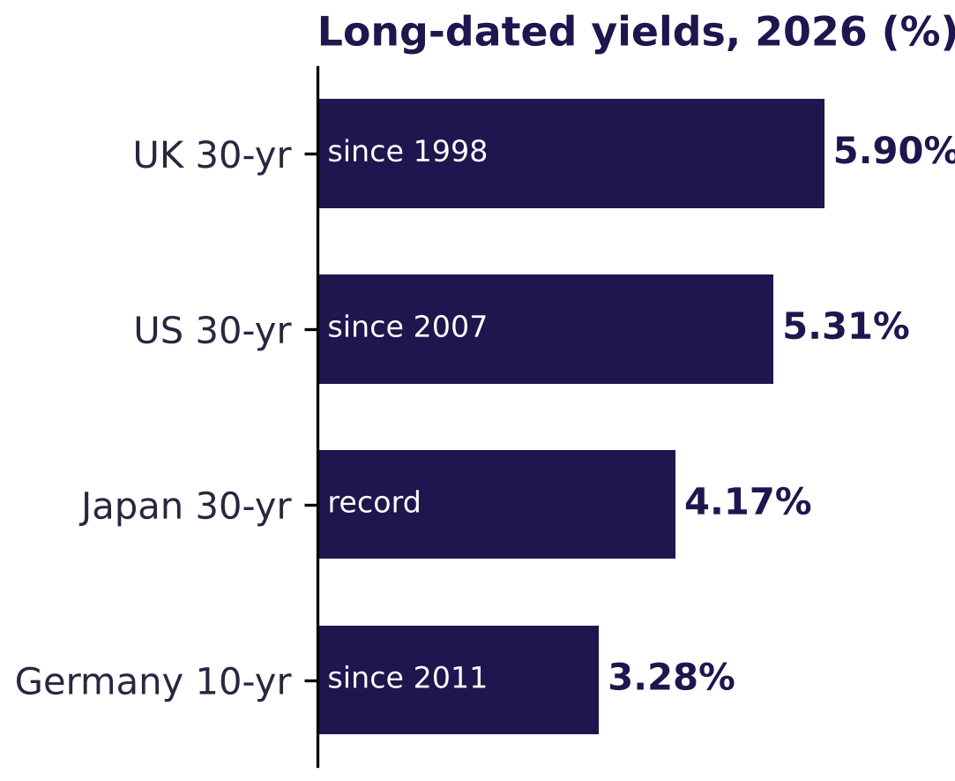
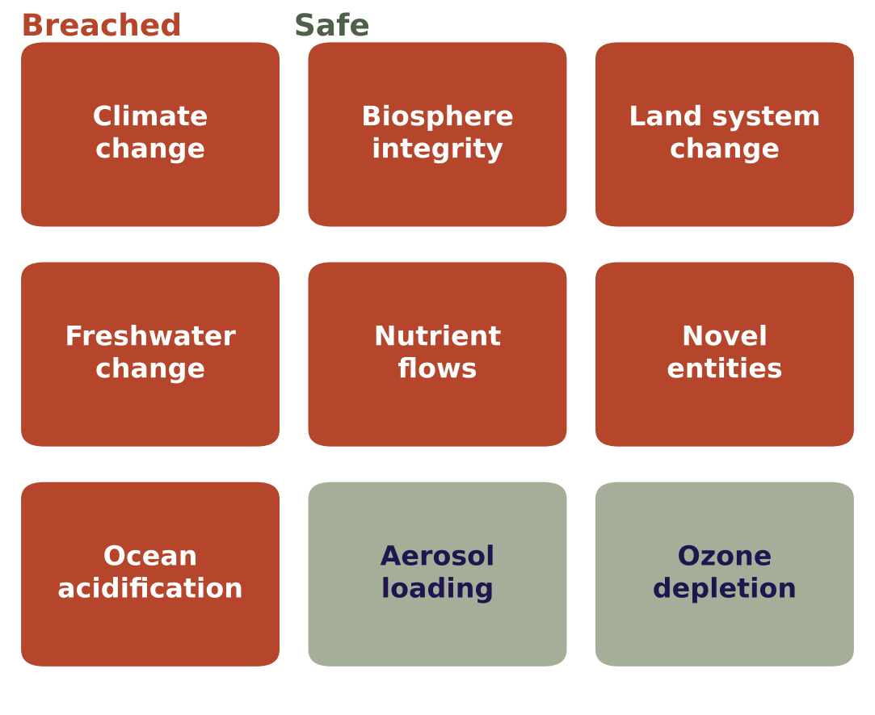


September 2026
M | T | W | T | F | S | S
 | 1 | 2 | 3 | 4 | 5 | 6
7 | 8 | 9 | 10 | 11 | 12 | 13
14 | 15 | 16 | 17 | 18 | 19 | 20
21 | 22 | 23 | 24 | 25 | 26 | 27
28 | 29 | 30
UK 30-year borrowing cost highest since 1998
Seven of nine planetary boundaries breached
SEC moves to end shareholder proposals
Sources: Reuters; Ministry of Finance Japan; FRED; Bundesbank; PIK; Cooley; Dechert. Charts: Faith in RI. Photo: David (dbking), CC BY 2.0
Notes:
September. The UK's 30-year borrowing cost reached its highest since 1998. The Planetary Health Check found seven of nine planetary boundaries breached, all getting worse. And the SEC proposed ending the rule that lets shareholders file proposals. Financial and planetary limits are tightening just as investor rights narrow.

Slide 14
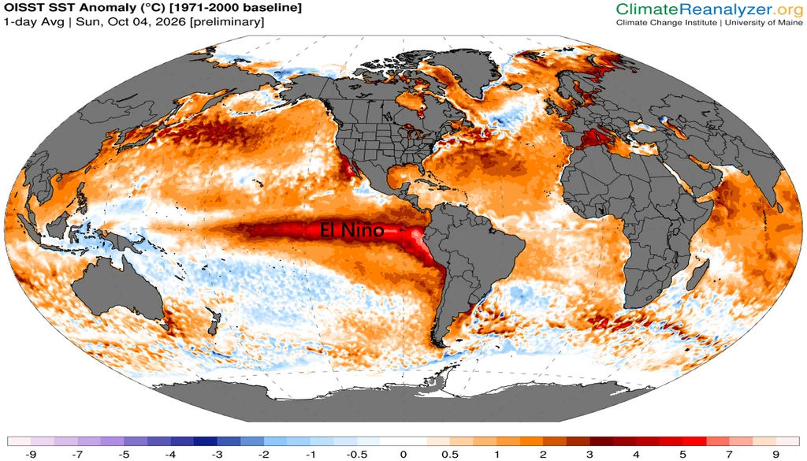
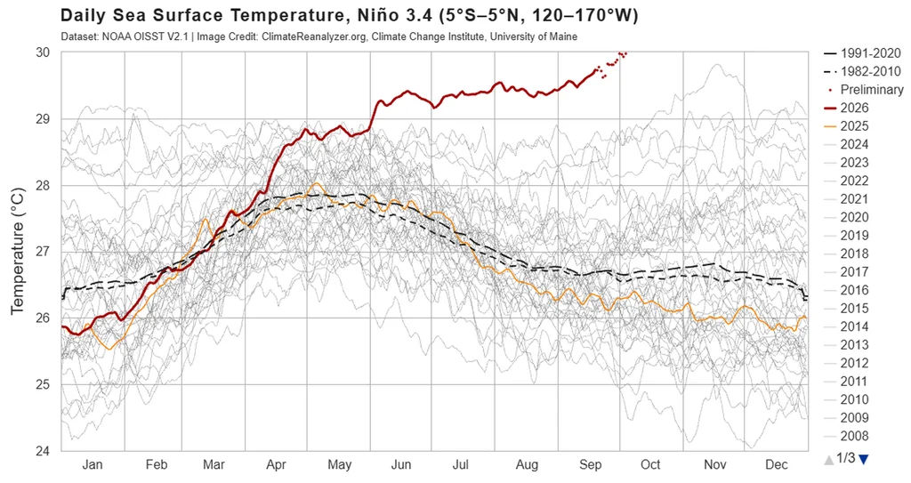

October 2026
M | T | W | T | F | S | S
 |  |  | 1 | 2 | 3 | 4
5 | 6 | 7 | 8 | 9 | 10 | 11
12 | 13 | 14 | 15 | 16 | 17 | 18
19 | 20 | 21 | 22 | 23 | 24 | 25
26 | 27 | 28 | 29 | 30 | 31
A super El Niño builds: 2027 set to be the hottest year yet
Sources: NOAA; Climate Reanalyzer, University of Maine
Notes:
October, and this Forum. Forecasters expect one of the strongest El Niño events on record, making 2027 very likely to be the hottest year yet measured. Every physical risk assumption we hold will be tested again.

Slide 15
Next year's headlines are
already being written.
NOV 2026
DEC 2026
JAN 2027
FEB 2027
MAR 2027
APR 2027
MAY 2027
JUN 2027
JUL 2027
AUG 2027
SEP 2027
OCT 2027
Notes:
And so we turn to a blank page. Step back and these are not two dozen separate stories. A war became an energy shock, then a food shock, then a fiscal one. Heat became fire, drought, flood and collapse. Nature became a security issue. And the rules that help us see and respond were loosened.
None of this can be diversified away, and all of it reaches the people whose savings we look after. Next year's headlines are already being written. As asset owners we hold more of the pen than we sometimes admit: through how we allocate, how we steward, and what we ask of policymakers.
So the question for this Forum is simple. What will each of us do differently by the time we meet again?

Slide 16
Important information
This presentation is provided for information and discussion only. It does not constitute investment, legal, tax or other professional advice, nor an offer or solicitation to buy or sell any security or financial instrument.
Facts and figures are drawn from publicly available sources as reported at the time and may since have been revised. While care has been taken, no representation or warranty is given as to their accuracy or completeness.
Views expressed are those of the presenter and do not necessarily reflect those of any organisation with which the presenter is or has been associated.
Third-party images and data remain the property of their respective owners and are reproduced with attribution and, where required, under licence.
Faith in RI Ltd. Registered in England and Wales, Company No. 17035433.

